Slide 1
Welcome to US Fleet Forces Command
DEPLOYMENT HEALTH ASSESSMENT (DHA) PROGRAM TRAINING
NOTE:
The link to the training presentation is available in the training announcement email and in the DHA Coordinator Training page at https://www.usff.navy.mil/dha.
Audio only: 410-874-6751
Conference ID: 118 311 513#
UNCLASSIFIED

Slide 2
Deployment Health Assessment
Deployment Health Assessments:
Congressionally mandated assessments used to screen Service members during all phases of their deployment, to identify physical and mental health concerns, and to facilitate appropriate care for identified issues.
Objective:
To increase the knowledge and awareness of those involved in the DHA process in order to better assist our Sailors and Marines in completing their DHAs and increase DHA compliance rate to meet the DoD minimum goal of >95% (DoDINST 6200.05).
UNCLASSIFIED

Slide 3
Agenda
DHA Policy and Process
DHA Responsibilities
DHA Population
Program Challenges
USFF DHA Bi-Weekly Update
Information Resources
Questions
UNCLASSIFIED

Slide 4
Deployment Health Policy
Policy:
DoD Instruction 6490.03. Deployment Health, 19 JUN 2019
DHA-PI 6490.03. Deployment Health Procedures, 17 DEC 2019
OPNAV Instruction 6100.3A. Deployment Health Assessment Process, 10 NOV 2014
Purpose:
To identify health concerns and facilitate evaluation, care, and education throughout the deployment cycle.
Requirements:
Deployment health assessments are required for all deployments ashore greater than 30 days outside the United States, and
For deployments and military operations based on health risk and the decision of the combatant commander, Service component commander or commander exercising operational control.
UNCLASSIFIED

Slide 5
Deployment Health Compliance Information
Pre-DHA (DD2795)
Due 120 days or less from theater entry date.
Form alone does not trigger “Deployment Event” in MRRS or requirement for DD2796 after deployment.
PDHA (DD2796)
Due between 30 days before and 30 days after theater departure date.
Overdue at 31 days after theater departure date.
Expires: at 89 days after theater departure, as DD2900 (PDHRA) is due beginning 90 days after theater departure date.
PDHA (D2796) is no longer required once the PDHRA (DD2900) is DUE. Complete and certify the DD2900 (PDHRA) instead.
PDHRA (DD2900)
Due between 90 and 180 days after theater departure date.
Overdue 181 days after theater departure date.
Expires: Does not expire.
Exception: Another deployment cycle begins and D2795 (Pre-DHA) is completed.
UNCLASSIFIED
5

Slide 6
DHA Exemptions
Shipboard operations that are not anticipated to involve operations ashore or health risks that are beyond the scope of standard shipboard occupational health programs.
Deployments of shorter duration, 30 days or less, outside the United States.
Deployments within the United States and its Territories.
Deployments to enduring locations within operational areas, i.e., Japan, South Korea, Germany, Spain, Italy, and Bahrain (Manama).
Enduring Location – A geographic site designated by the DoD for strategic access and use to support U.S. security interests for the foreseeable future (DoDINST 3000.12).
Note: Shipboard deployments on foreign vessels are NOT exempt from the deployment-related health assessments.
UNCLASSIFIED
Notes:
DoDI 3000.12 May 6, 2016
4.1. ELML. The DoD maintains, and operates from, foreign locations and U.S. territories to accommodate an adjustable force presence as well as the necessary flexibility to respond to crises and ensure homeland defense. The ELML is a record of these locations. It is managed by the OUSD(P) and includes the locations where the United States is expected to have a security interest for the foreseeable future. The DepSecDef approves DoD validation of enduring locations.

Slide 7
Commander Directed DHAs
NORTHCOM - DRHAs are required for deployments to Southern Border Operations (Shipboard deployments are exempt).
ASD HA Memo, 6 Mar 2025 – Completing DRHAs Associated with Deployment to Southern Border Operations.
CSGs, Navy Surface Forces Commanders – Identified Service members deploying to, redeploying from (returning from deployment), or have redeployed (returned) from the Weapons Engagement Zone (WEZ) in the CENTCOM AOR are required to complete the DHAs.
CENTCOM – DHAs are required for deployments to AOR except Bahrain and shipboard.
NAVCENT – DHAs are required for deployments greater than 30 days on ground to Isa AB Bahrain.
SOUTHCOM – DHAs are required for deployments greater than 30 days on ground to GTMO Cuba.
UNCLASSIFIED
Notes:
4 March 2024 email from Dr. Glogower, Health Assessment Program Manager, Health Readiness Support Division, Defense Health Agency Public Health, NORTHCOM requires the DRHAs.

Slide 8
Commander Directed DHA Process
Combatant commander, Service component commander or commander exercising operational control issues a directive/mandate to unit(s) to complete the DHAs due to health threats/concerns during the deployment, regardless of deployment location or duration.
Unit identifies Service members involved/associated with the deployment/incident and directs completion of the DHAs in EHA based on DHA compliance timeframes.
Unit representative with MRRS access (usually medical) creates the DHA requirement in MRRS Deploy tab and monitors compliance.
USFF BUMED DHA FM can assist in mass upload of DHA requirements in MRRS and can track/provide compliance update per EHA and MRRS upon request.
To assist with the process, the Unit POC must provide a roster of deploying/redeployed Service members to USFFC (EA for DHA per OPNAVINST 6100.3A). The roster must include: UIC, Unit Title, Name, Rank, DoD ID, Theater Entry Date, Theater Departure Date, Destination COCOM, Deployment Location/Country, and Unit POC.
UNCLASSIFIED

Slide 9
Commander Directed DHAs
For the Marine Corps
Due to the nature and ability of UDPs and MEUs to be redirected to “hotspots,” Marines on UDP or MEU require the Pre-DHA DD2795 regardless of where they are permanently stationed or coming from.
Marines on exercises which are outside the U.S. for greater than 30 days require DRHAs.
Embassy Security Guard Marines are required to complete DRHAs unless the country location is on the Enduring Locations Master List.
Marines deploying to Bahrain, regardless of location within the country, are required to complete the DRHAs.
Note: Info provided by HQMC M&RA/MI Division. POC: Ms. Leanne Miller at leona.miller.ctr@usmc.mil
UNCLASSIFIED

Slide 10
Deployment Health Compliance
DoDI 6490.03, Deployment Health, 19 JUN 2019; DHA-PI 6490.03, Deployment Health Procedures, 17 DEC 2019; OPNAVINST 6100.3A, DHA Process, 10 NOV 2014
Purpose:
To identify health concerns and facilitate evaluation, care and education throughout the deployment.
Requirements:
Deployments ashore greater than 30 days outside of the United States or Commander directed.
Exemptions:
Routine shipboard deployments; Deployments of 30 days or less; Deployments within US and its territories; Deployments to enduring locations, i.e., Japan, South Korea, Spain, Italy, Germany, & UK.
Deployment-Related Health Assessments Requirements Timeframe
DD2795
Pre-DHA
DD2978
IT MHA
DD2796
PDHA
DD2900
PDHRA
DD2978/ DD3024
DMHA
1 YR/PHA
DD2978/ DD3024
DMHA
2 YR/PHA
Required for every 180 days deployed while in theater.
Online form and provider certification
Required between 30 days prior and 30 days after deployment return
Online form and provider certification
(contains DMHA required questions)
Required between 90-180 days after deployment return BUT DOES NOT EXPIRE
Online form and provider certification
PHA periodic health assessment or standalone DMHA
Required within 546-910 days after redeployment (18 months-30 months) BUT DOES NOT EXPIRE
Online form and provider certification
(contains DMHA required questions)
Required within 120 days prior to deployment
Online form and provider certification
PHA periodic health assessment or standalone DMHA
Required within 181-545 days after deployment return (181 days-18 months)
Online form and provider certification
UNCLASSIFIED
Notes:
DHA Requirement: Sailors deployed ashore greater than 30 days outside the US or when the combatant commander, service component commander, or commander exercising operational control deems it necessary due to a health threat exists.
(a) Post-Deployment Health Assessment. Supporting DoD Components ensure that the DD Form 2796 is completed within 30 days before or after return from deployment.
(b) Post-Deployment Health Re-Assessment. Supporting DoD Components will ensure that the DD Form 2900 is completed within 90 and 180 days after return from deployment.
(c) Deployment Mental Health Assessments (MHA). The DD Form 2978 is required for Service members in the timeframe from the date of redeployment until 21 days after return from redeployment leave. Completing the Post Deployment Health Assessment, DD Form 2796, or the Annual Periodic Health Assessment (PHA), DD Form 3024, or the SHPE/SHA during this timeframe, fulfills the MHA requirement. The DD Form 2978 is also required 181 days to 18 months and 18 to 30 months after return from deployment. Completing the Annual Periodic Health Assessment (PHA), DD Form 3024, during these timeframes fulfills the MHA requirement. These post-deployment mental health assessments are not required for DoD civilians.
(d) When individuals deploy again prior to completing the cycle of deployment-related health assessments, the assessment schedule will be re-set as described in Appendix 5

Slide 11
Responsibilities
OPNAVINST 6100.3A – DHA Process
Owner | Role
Deputy Chief Of Naval Operations (Manpower, Personnel, Training, and Education) CNO (N1)) | Develop and maintain deployment health assessment policy. Provide quarterly compliance report to CNO. Ensure MRRS supports the DHA reporting process. Maintain interface with Navy and DoD information systems for DHA process.
Commander USFF (Supported Commander) | As Executive Agent (EA) monitor compliance and ensure policy enforcement. Produce Quarterly PDHA/PDHRA Compliance reports to CNO via OPNAV N17. Conduct monthly DHA Program Training.
BUMED | Provide medical support services to complete DHA. Ensure individual IMR is accurate and current to facilitate smooth deployment process. Provide OPNAV (N17) medical policy guidance related to DHA process. Provide health record review for DHA deficiencies upon check-in and check-out. DHA review should be a stand-alone item on the medical check-in and check-out sheet.
UNCLASSIFIED
11

Slide 12
Responsibilities (cont.)
Owner | Role
Echelon II commands | Submit monthly reports to USFF. Monitor and ensure DHA compliance for all personnel who require DHA in their AOR.
Navy and Marine Corps Force Health Protection Command (NMCFHPC) | Maintain the EHA - Electronic Deployment Health Assessment (EHA - eDHA) database and analysis of DHA information.
Commanding Officers | Ensure targeted Service members are briefed on deployment health threats. complete required DHAs. receive the appropriate follow up PDHA and PDHRA in coordination with medical providers. DHA status is validated as part of check-in and check-out process.
Individual Sailor/Marine | Personal readiness and completion of mandated DHA requirements during periodicity.
Mobilization & Deployment Support Center (MDSC) | Ensure reporting Service members deploying to areas requiring physical health assessments complete the Pre-DHA prior to departure and the PDHA upon return.
UNCLASSIFIED
12

Slide 13




DRHA Process
Systems and tools for program compliance & monitoring
EHA – eDHA/ePHA
(Defense Health Agency)
Medical
Provider
(NAVMED)
Service Member is Identified (MRRS)
Pre-DHA
DD2795
AFHSD - DMSS
(DoD Repository)
Pre-DHA
IT MHA
DD2978
PDHA
PDHA
DD2796
PDHRA
DD2900
PDHRA
Form is certified in eHA after medical provider interview. RC and AC Remote Sailors may phone the call center at 1-833-782-7477 for the PDHRA.
DMHA DD2978
3-5 work days
Forms submitted electronically
Service Member’s
Command
PHA
DD3024
Note: RC and AC remote Service members with no access to MTF may use the QTC Portal at https://smp.qtcm.com to complete the PDHRA.
NFAAS
(IAs only)
(CNIC)
MRRS
(NPC)
Navy - US Fleet Forces Command Oversight
USMC – Headquarters Marine Corps Oversight
weekly
UNCLASSIFIED
Notes:
Command identifies Service members and directs completion of DRHA in EHA. Service member completes the form and schedule an appointment for healthcare provider interview. After the interview, healthcare provider certifies the form in EHA. The following work day, certified DRHAs are sent by the EHA staff to the Armed Forces Surveillance Branch (AFHSB) for inclusion in the DoD repository, the Defense Medical Surveillance System (DMSS). AFHSB staff process/store the DRHA in DMSS and sends the completion data to MRRS. Once processed, the completion dates appear in the Service member’s MRRS Deploy tab. It takes about 3 – 5 work days from the certification date for DRHAs to reflect in MRRS. For IA redeployers, every Monday MRRS staff sends PDHA and PDHRA completion dates to NFAAS for data received the previous week. Tracking PDHA/PDHRA is an added support provided to IA Sailors by the Command Individual Augmentee Coordinator (CIAC).
DRHA must be certified by a medical provider to be complete.
- If DRHA was completed in other branch of service’s system (ASIMS – Air Force; MEDPROS – Army), the DRHA is transferred over to the AFHSB DoD Repository then transferred over to MRRS.

Slide 14
Complete a Deployment Health Assessment
Completing a DHA (Pre-DHA/DD2795, PDHA/DD2796, or PDHRA/DD2900) is a two-part process:
1) Fill out and submit the DHA form online via the EHA Web application at https://eha.health.mil/eha/. For PDHRA only: Reserve component and Active component Service members remotely-located (TriCare Prime Remote enrolled and without access to a military treatment facility (MTF)) can utilize the DoD RHRP contract support services, QTC, to complete the PDHRA/DD2900. The Service member must register on the QTC portal first using the following link https://smp.qtcm.com.
2) Once the DHA is submitted on-line, please schedule a person-to-person assessment with a medical provider at the nearest MTF to have your DHA medically certified. For PDHRA only: Reserve component and Active component Service members remotely-located (TriCare Prime Remote enrolled and without access to an MTF) can utilize the DoD RHRP Call Center at 1-833-782-7477 for medical certification.
For issue logging-in to EHA, contact the Help desk: (757) 900-9050 or (757)953-0737 or email at usn.hampton-roads.navmcpubhlthcenpors.list.nmcphc-pha1@health.mil.
For Sailors supported by other Services’ medical facility, the DHA can be completed in MEDPROS (Army) or ASIMS (Air Force).
Please visit https://www.usff.navy.mil/dha for Navy Deployment Health related information.
UNCLASSIFIED

Slide 15
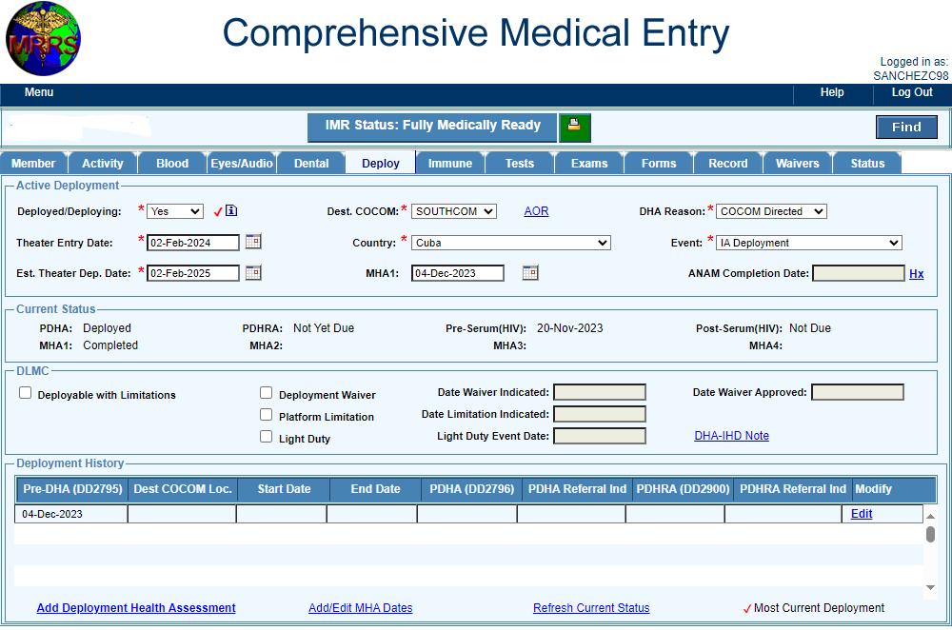
Identifying the DHA Population
Pre-Deployment
Deployed
ReDeployment
Parent Unit via Medical
NFAAS
Completed PDHA
Manual
Self-Identified
Semi-
Automated
Self- Identified Automated
Name & Last 4 SSN
UNCLASSIFIED

Slide 16
Program Challenges
No automated pay and personnel integrated system for deployment health assessment accounting.
MRRS user error - incomplete deployment data; deployment events with unmet DHA criteria; duplicate deployment events; manual entries of DHA completion dates.
Lack of maintenance of deployment information in MRRS – orders cancelled or modified; Not exempting for PDHA/PDHRA when SM remained in enduring location; SM deployed again.
Lack of knowledge of staff that provide DHA support.
Gun decking of DHA completion.
MRRS and NFAAS PDHA/PDHRA due and overdue notification being ignored by SM.
Service member completing the wrong form and medical provider certifying the wrong form or all uncertified forms.
UNCLASSIFIED

Slide 17
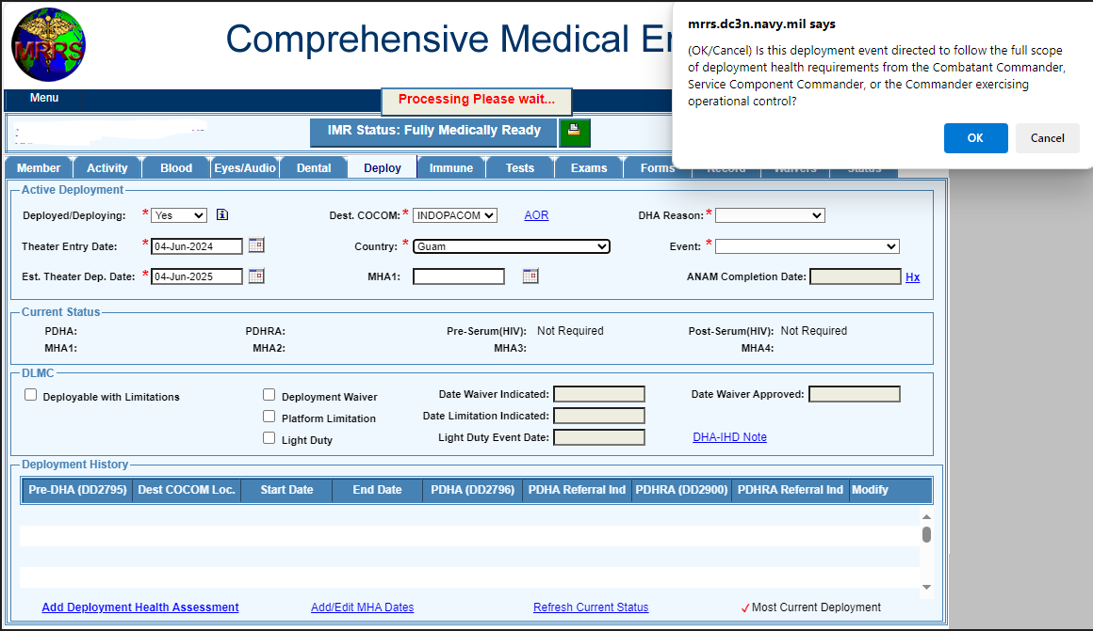
Deploy Tab Functions
UNCLASSIFIED

Slide 18
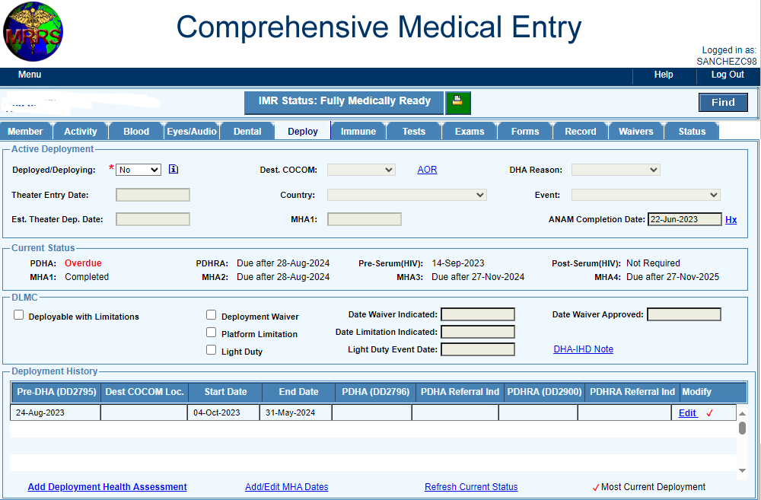
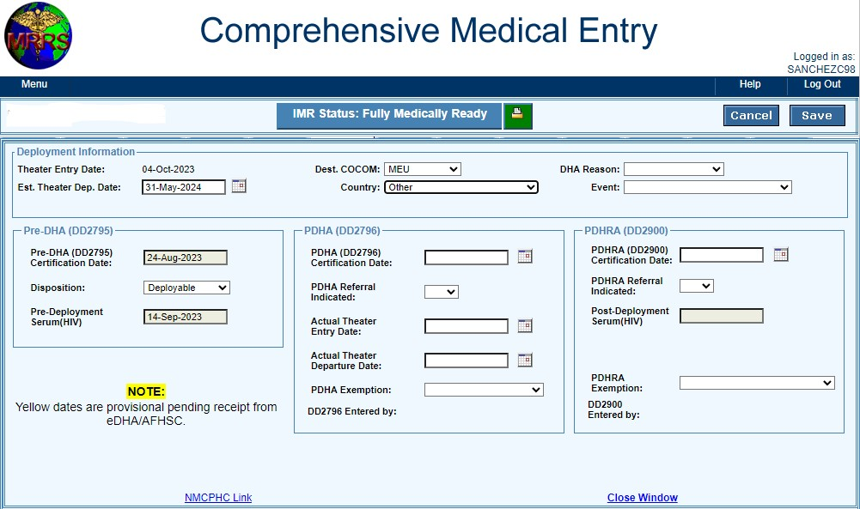
MEU Deployment w/ Overdue PDHA
UNCLASSIFIED

Slide 19
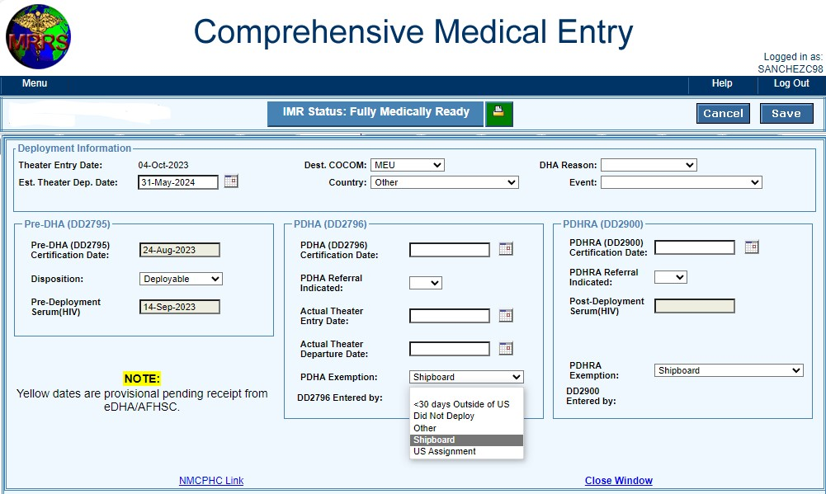
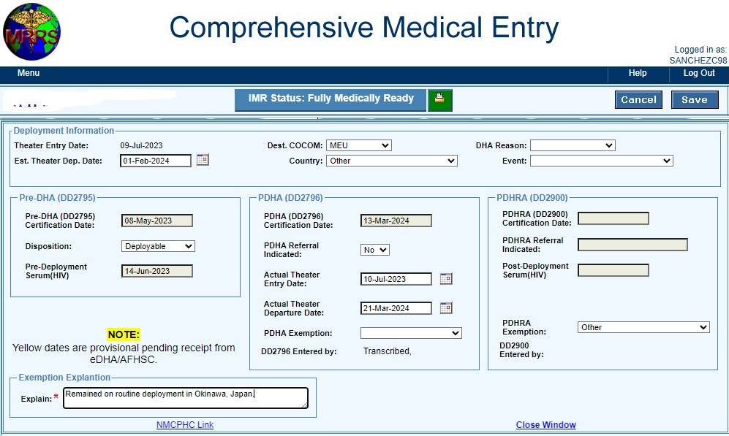
PDHA/PDHRA Exemptions
UNCLASSIFIED

Slide 20
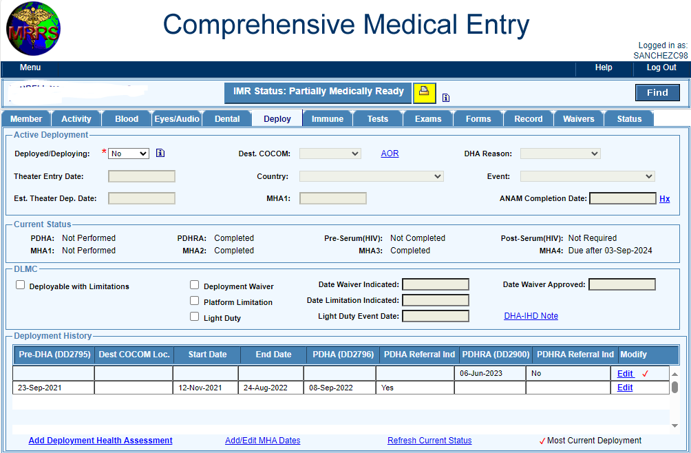
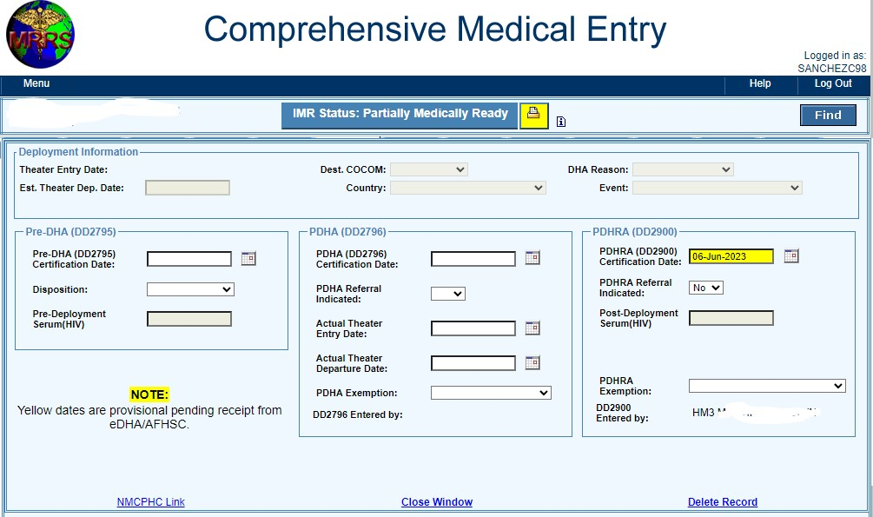
DHA Manual Entry
Note: Manual entry of DHA completion is not required and strongly discouraged.
Do not use!
No deployment data
Note: If manual entry of DHA completion is necessary, ensure you are transcribing the data from the EHA system or other supporting documents.
UNCLASSIFIED

Slide 21
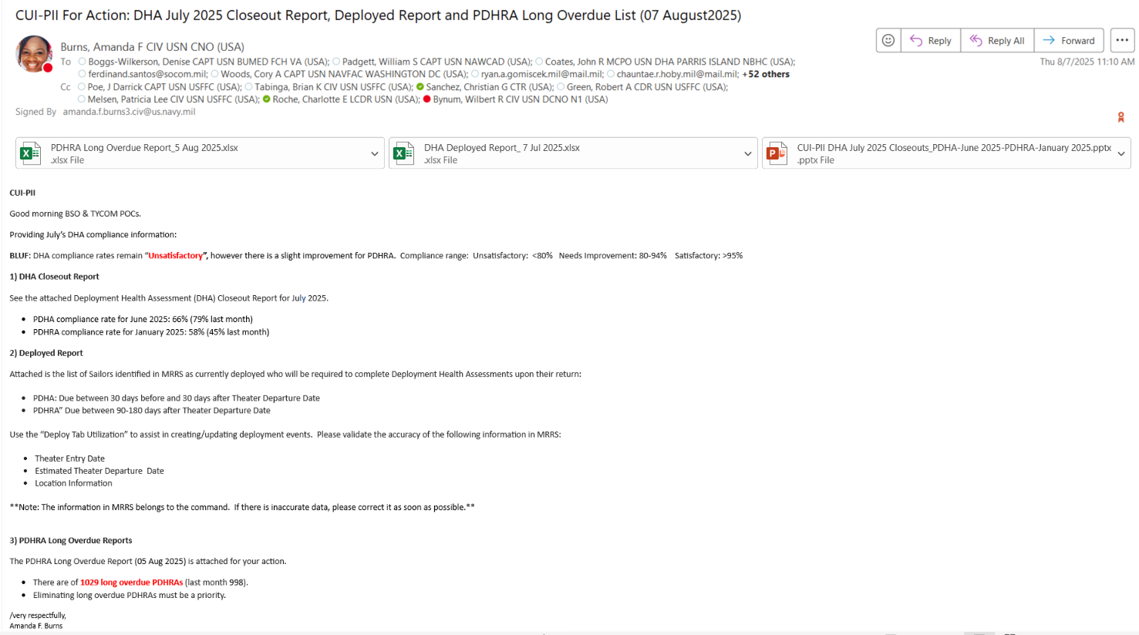
DHA Compliance Biweekly Update
CUI - PII

Slide 22
July 2025 Closeouts for June 2025 Redeployers (PDHA) and January 2025 Redeployers (PDHRA) February, March and April 2025 PDHRA Leading Indicators PDHRA Long Overdue Report
05 August 2025
CUI

Slide 23
PDHA (DD2796) Report Card – June 2025 Redeployers Closeout
NEW: The spreadsheet for all PDHA closeout statuses for June 2025 redeployers are now in one file, different worksheets, on Slide 4.
CUI

Slide 24
PDHRA (DD2900) Report Card – January 2025 Redeployers Closeout
NEW: The spreadsheet for all PDHRA closeout statuses for January 2025 redeployers are now in one file, different worksheets, on Slide 4.
Note: If “Completed Early/Late” and “Overdue” assessments are completed within the window, PDHRA Compliance Rates would significantly increase. Request commands place highest emphasis directed on redeployers to complete PDHRA within allotted timeframe (between 90-180 days of return) for compliance.
All Overdue PDHRAs must still be completed.
CUI

Slide 25
PDHRA (DD 2900) Leading Indicators ( February, March, & April 2025 Redeployers - In the Window)
NEW: The spreadsheet for all PDHRA Leading Indicators for those redeployers who will need to complete the PDHRA for February, March, & April 2025 redeployers is in the file below with different worksheets.
Remember: Completing assessments outside of the defined window (between 90 – 180 days) goes against the Compliance Rates.
CUI

Slide 26
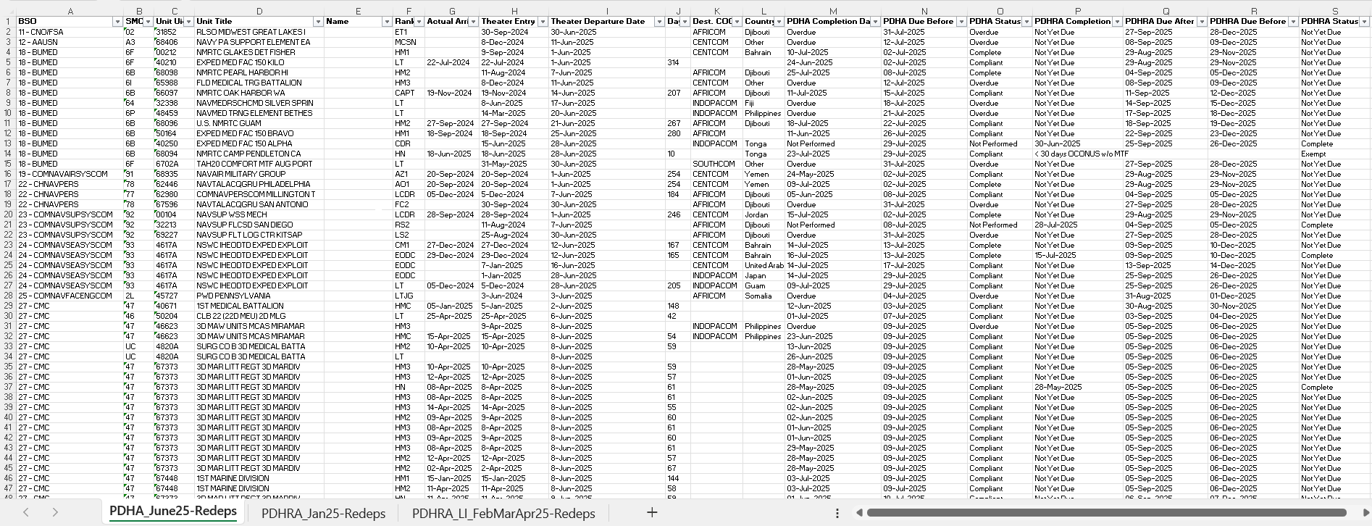
DHA July 2025 Closeout Data
CUI

Slide 27


Impact if DHA Requirements were not Met
Short Term
Increased chance of health needs unmet
Negative effect on PHA, IMR, PRT completion
Command readiness & effectiveness degraded
Long Term
Consequences of unaddressed health needs
No evidence-based association of exposure to long term health affects
Failure to meet Congressionally mandated program
UNCLASSIFIED

Slide 28
Navy DHA Information Resources
USFF DHA Webpage: https://www.usff.navy.mil/dha
DoD RHRP - PDHRA Call Center: (833)782-7477
DoD RHRP - QTC Portal: https://smp.qtcm.com
EHA Webpage: https://eha.health.mil/eha/
EHA Help Desk: (757)953-0737/DSN 377 or email at usn.hampton-roads.navmcpubhlthcenpors.list.nmcphc-pha1@health.mil
New MRRS Webpage: https://mrrs-cloud.dc3n.navy.mil/mrrs/secure/welcome.m
MRRS Customer Support - NESD: (833)637-3699
Ms. Amanda Burns – OPNAV N17 DHA PM Email: amanda.f.burns3.civ@us.navy.mil
Mr. Christian Sanchez – USFF BUMED PDHRA FM (757)613-3183 Email: christian.g.sanchez.ctr@us.navy.mil
UNCLASSIFIED

Slide 29


